Slide 1
Samsung Flip
Hardware and Technology Specifications

Slide 2
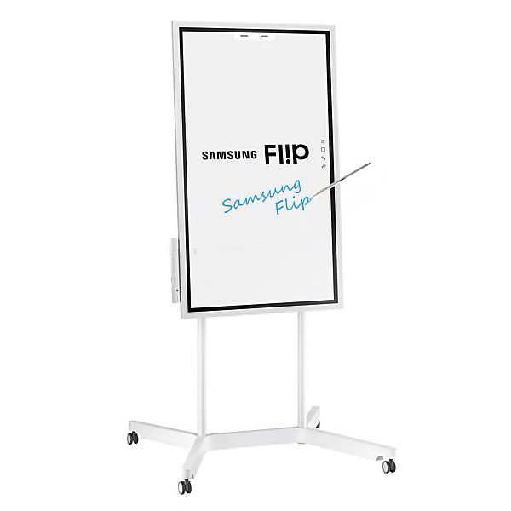
Basic Physical Specifications
Panel : 55” 60 Hz LED
Body Dimension(mm) : 1302.6 X 805.5 X 52.0
Weight of package: 34.9 kg
Typical Power Consumption: 100 W/h
Recommended Humidity : 10% - 80%

Slide 3
Basic Internal Specifications
Processor: CA72 Quad(1.7 GHz)
Clock Speed: 1.7 GHz CPU Quad
Operating System: Samsung Proprietary OS (VDLinux)
Storage: 8GB (2.65GB Occupied by O/S, 5.35GB Available )

Slide 4

Ways to connect
HDMI
Screen Mirroring
Wifi-out connectivity
NFC
USB

Slide 5
Primary Sensors
Hall Sensor ( Wakes up the display when passive pen is removed from the holder)
Accelerometer (Detects rotation of frame and adjusts UI accordingly)
Proximity Sensor ( Wakes up screen when senses a person approaching close)

Slide 6
Now let’s get into the details.

Slide 7
Display
Resolution : 3840 X 2160
Response Time : 8ms

Slide 8
Screen
UHD Display
Better resolution which supports screen mirroring from small devices.
Four Width object recognition
It can detect passive object of 4 different sizes 2 / 4 / 8 / 50 mm
Multi- writing upto 4 people
It can differentiate between the 4 collaborators so they all can write with different colors at the same time

Slide 9

InGlass Technology
Previously p-cap and IR-based touch was used. But problems associated with these are loss of clarity in large sized display, huge bezels, no support for multi-touch and susceptible to dust.
Samsung Flip uses InGlass technology developed by FlatFrog.

Slide 10
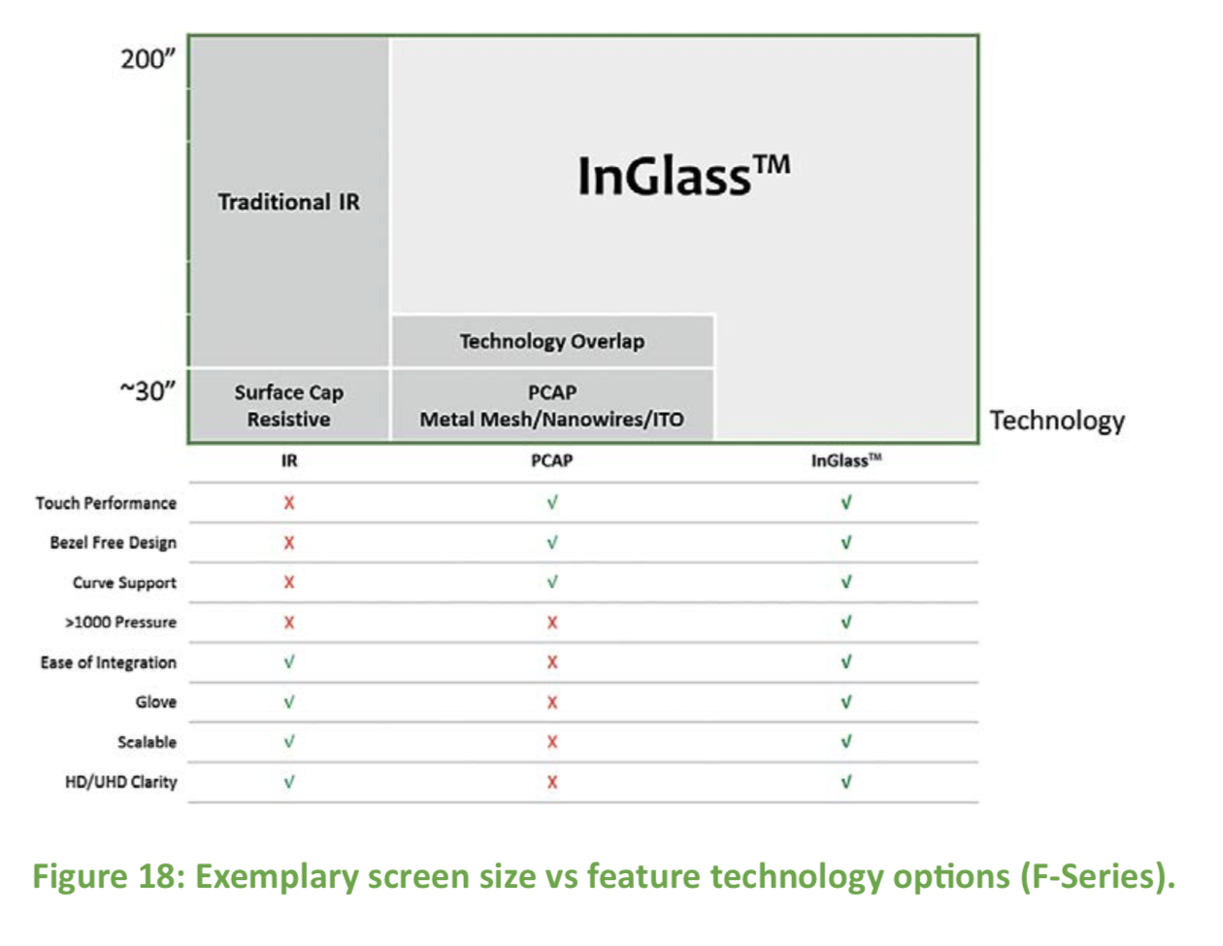
Source: https://www.flatfrog.com/whitepapers

Slide 11
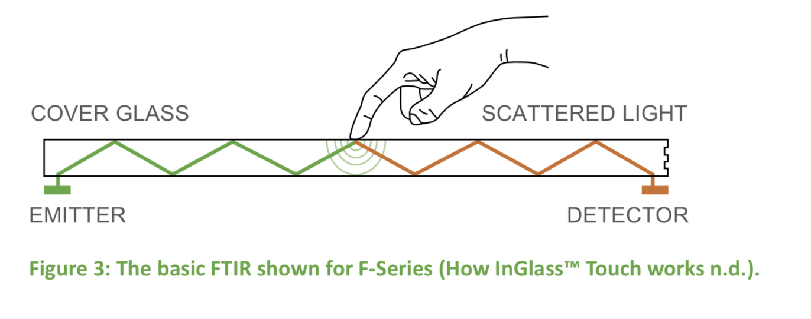
Source: https://www.flatfrog.com/whitepapers

Slide 12

Developer Specification
Operating System : Tizen 3.0 (VDLinux) used by wide range of Samsung Devices.
Programming language : Python

Slide 13
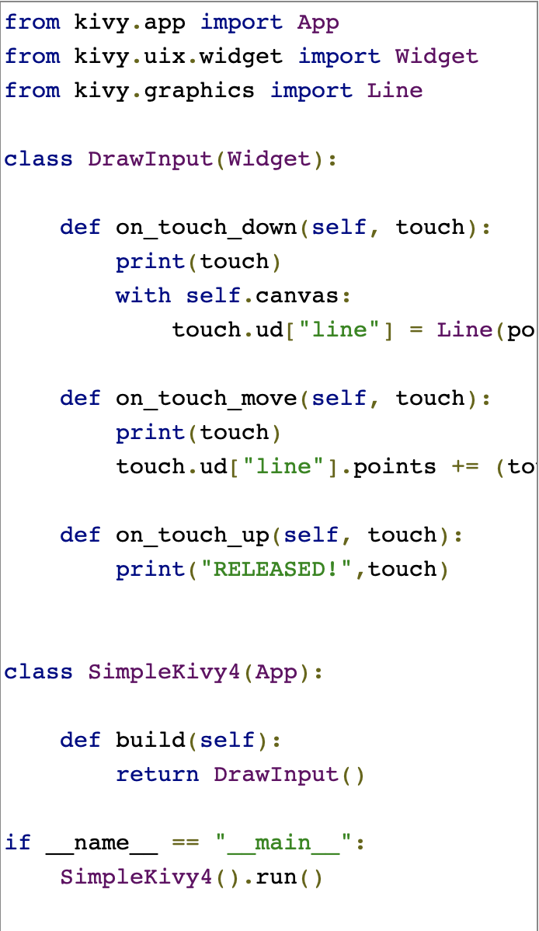
Obtaining logs
Install pygame
Install kivy module using pip install
Run the following code.
Connect the computer to HDMI and USB port.
Source: https://pythonprogramming.net/kivy-drawing-application-tutorial/

Slide 14
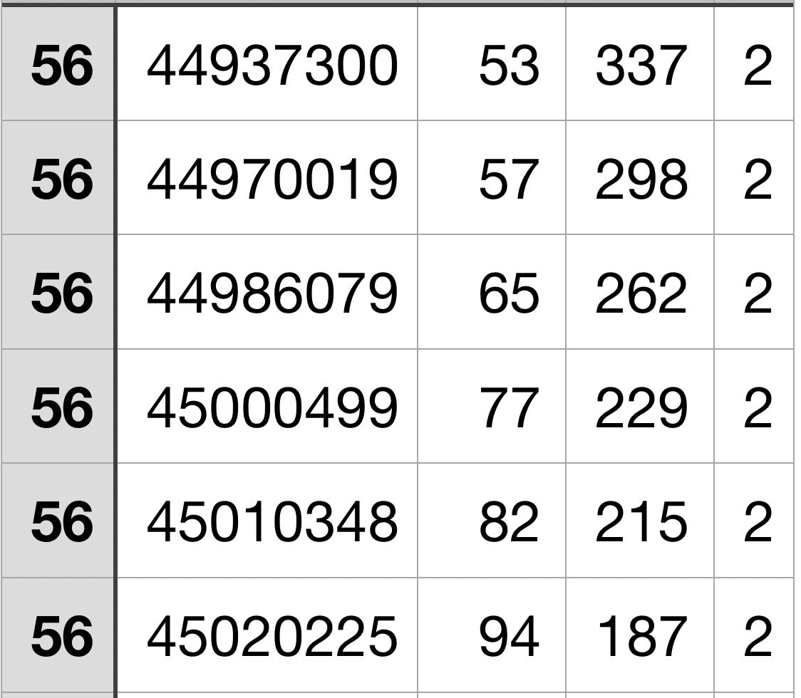
Time Stamp
x-coordinate
y-coordinate
0- starting to write (pen down)
1- currently writing
2- pen up event
Logs obtained from the device using the Kivy Module on Python

Slide 15
Problems/ Challenges
“ Houston, we have a problem! ”

Slide 16
Problem of Latency
Appreciable time delay between fast movement of passive pen and the response on the display

Slide 17
Problem of Unwanted erasing
Software isn’t able to differentiate between intended and unintended erasing.

Slide 18
Initial proposal to solve the problem
We will try to make a logistic regression model that will be able to classify the palm touches as intended to erase or not.
We thought of deep neural network but the computational time will introduce latency.
The primary features that we will in the model will be :-
Distance from pen
Shape of patch
Direction of movement of palm
Speed of the palm with respect to the pen

Slide 19
Problem of Big Palm
Software detects the area of palm in contact larger that what is actually in contact

